Slide 1
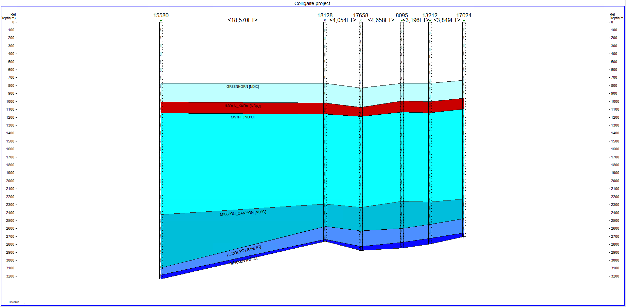
<1,480 m>
<1,230 m>
Town of Mandaree

Slide 2
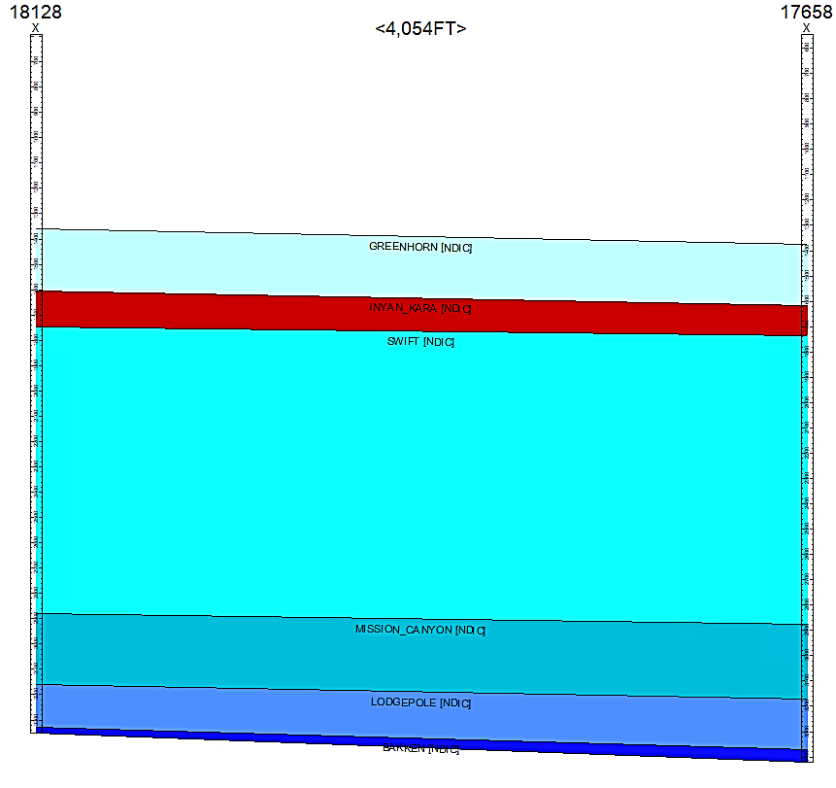
Depth m

